Slide 1
LESSON 15

Slide 2
Overview
of
Previous Lesson(s)

Slide 3
Over View
Strategies that have been used to implement and optimize pattern matchers constructed from regular expressions.
The first algorithm is useful in a Lex compiler, because it constructs a DFA directly from a regular expression, without constructing an intermediate NFA.

Slide 4
Over View..
The second algorithm minimizes the number of states of any DFA, by combining states that have the same future behavior.
The algorithm itself is quite efficient, running in time O(n log n), where n is the number of states of the DFA.
The third algorithm produces more compact representations of transition tables than the standard, two-dimensional table.

Slide 5
Over View...
A state of NFA can be declared as important if it has a non-ɛ out-transition.
NFA has only one accepting state, but this state, having no out-transitions, is not an important state.
By concatenating a unique right endmarker # to a regular expression r, we give the accepting state for r a transition on #, making it an important state of the NFA for (r) #.

Slide 6
Over View...
firstpos(n) is the set of positions in the sub-tree rooted at n that correspond to the first symbol of at least one string in the language of the sub-expression rooted at n.
lastpos(n) is the set of positions in the sub-tree rooted at n that correspond to the last symbol of at least one string in the language of the sub expression rooted at n.

Slide 7
Over View...
followpos(p) , for a position p, is the set of positions q in the entire syntax tree such that there is some string x = a₁ a₂ . . . a_{n} in L((r)#) such that for some i, there is a way to explain the membership of x in L((r)#) by matching a_{i} to position p of the syntax tree and a_{i+1} to position q

Slide 8
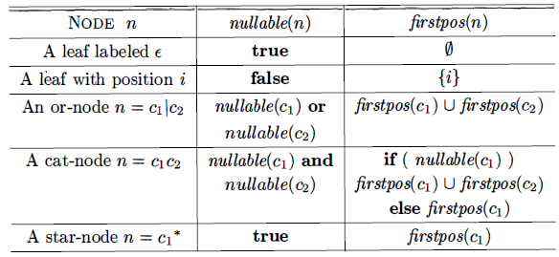
Over View...
nullable, firstpos, and lastpos can be computed by a straight forward recursion on the height of the tree.

Slide 9
Over View...
Two ways that a position of a regular expression can be made to follow another.
If n is a cat-node with left child C₁ and right child C₂ then for every position i in lastpos(C₁) , all positions in firstpos(C₂) are in
followpos(i).
If n is a star-node, and i is a position in lastpos(n) , then all positions in firstpos(n) are in followpos(i).

Slide 10
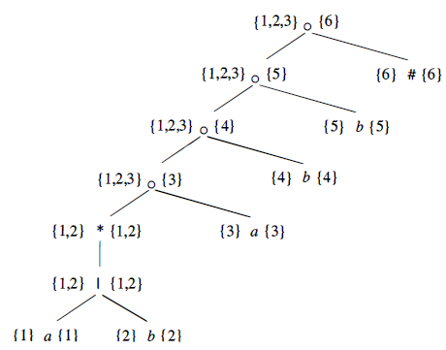
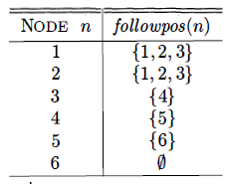
Over View...
Ex. DFA for the regular expression r = (a|b)*abb
Putting together all previous steps:
Augmented Syntax Tree r = (a|b)*abb#
Nullable is true for only star node
firstpos & lastpos are showed in tree
followpos are:

Slide 11
Over View...
Start state of D = A = firstpos(rootnode) = {1,2,3}
Then we compute Dtran[A, a] & Dtran[A, b]
Among the positions of A, 1 and 3 corresponds to a, while 2 corresponds to b.
Dtran[A, a] = followpos(1) U followpos(3) = { l , 2, 3, 4}
Dtran[A, b] = followpos(2) = {1, 2, 3}
State A is similar, and does not have to be added to Dstates.
B = {I, 2, 3, 4 } , is new, so we add it to Dstates.
Proceed to compute its transitions..

Slide 12
TODAY’S LESSON

Slide 13
Contents
Optimization of DFA-Based Pattern Matchers
Important States of an NFA
Functions Computed From the Syntax Tree
Computing nullable, firstpos, and lastpos
Computing followups
Converting a RE Directly to DFA
Minimizing the Number of States of DFA
Trading Time for Space in DFA Simulation
Two dimensional Table
Terminologies

Slide 14
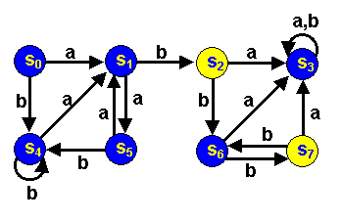
Minimizing DFA States
Following FA accepts the language of regular expression (aa + b)*ab(bb)*
Final states are colored yellow while rejecting states are blue.

Slide 15
Minimizing DFA States..
Closer examination reveals that states s₂ and s₇ are really the same since they are both final states and both go to s₆ under the input b and both go to s₃under an a.
So, why not merge them and form a smaller machine?
In the same manner, we could argue for merging states s₀ and s₅.
Merging states like this should produce a smaller automaton that accomplishes exactly the same task as our original one.

Slide 16
Minimizing DFA States...
From these observations, it seems that the key to making finite automata smaller is to recognize and merge equivalent states.
To do this, we must agree upon the definition of equivalent states.
Two states in a finite automaton M are equivalent if and only if for every string x, if M is started in either state with x as input, it either accepts in both cases or rejects in both cases.
Another way to say this is that the machine does the same thing when started in either state

Slide 17
Minimizing DFA States...
Two questions remain.
First, how does one find equivalent states ?
Exactly how valuable is this information?
For a deterministic finite automaton M, the minimum number of states in any equivalent deterministic finite automaton is the same as the number of equivalence groups of M's states.
Equivalent states go to equivalent states under all inputs.

Slide 18
Minimizing DFA States...
Now we know that if we can find the equivalence states (or groups of equivalent states) for an automaton, then we can use these as the states of the smallest equivalent machine.
Ex Automaton

Slide 19
Minimizing DFA States...
Let us first divide the machine's states into two groups: Final and Non-Final states.
These groups are:
Final states = A = {s₂, s₇}
Non Final States = B = {s₀, s₁, s₃, s₄, s₅, s₆}
Note that these are equivalent under the empty string as input.

Slide 20
Minimizing DFA States...
Now we will find out if the states in these groups go to the same group under inputs a and b
The states of group A both go to states in group B under both inputs.
Things are different for the states of group B.

Slide 21
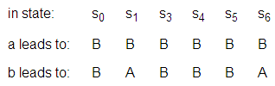
Minimizing DFA States...
The following table shows the result of applying the inputs to these states.
For example, the input a leads from s₁ to s₅ in group B and input b leads to to s₂ in group A.
Looking at the table we find that the input b helps us distinguish between two of the states (s1 and s6) and the rest of the states in the group since it leads to group A for these two instead of group B.

Slide 22
Minimizing DFA States...
The states in the set {s₀, s₃, s₄, s₅} cannot be equivalent to those in the set {s₁, s₆} and we must partition B into two groups.
Now we have the groups:
A = {s₂, s₇}, B = { s₀, s₃, s₄, s₅}, C = { s₁, s₆}
The next examination of where the inputs lead shows us that s₃ is not equivalent to the rest of group B.
We must partition again.

Slide 23
Minimizing DFA States...
Continuing this process until we cannot distinguish between the states in any group by employing our input tests, we end up with the groups:
A = {s₂, s₇}, B = {s₀, s₄, s₅}, C = {s₁}, D = {s₃}, E = { s₆}
In view of the above theoretical definitions and results, it is easy to argue that all of the states in each group are equivalent because they all go to the same groups under the inputs a and b.

Slide 24
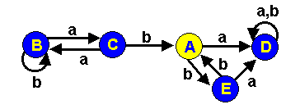
Minimizing DFA States...
Building the minimum state finite automaton is now rather straightforward.
We merely use our groups as states and provide the proper transitions.

Slide 25
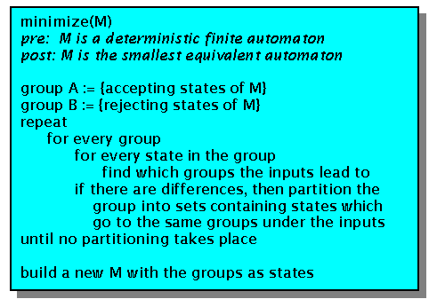
Minimizing DFA States...
State Minimization Algorithm:

Slide 26
Trading Time for Space in DFA
The simplest and fastest way to represent the transition function of a DFA is a two-dimensional table indexed by states and characters.
Given a state and next input character, we access the array to find the next state and any special action we must take, e.g. returning a token to the parser.
Since a typical lexical analyzer has several hundred states in its DFA and involves the ASCII alphabet of 128 input characters, the array consumes less than a megabyte.

Slide 27
Trading Time for Space in DFA..
Compilers are also appearing in very small devices, where even a megabyte of storage may be too much.
For such situations, there are many methods that can be used to compact the transition table.
For instance, we can represent each state by a list of transitions - that is, character-state pairs - ended by a default state that is to be chosen for any input character not on the list.

Slide 28
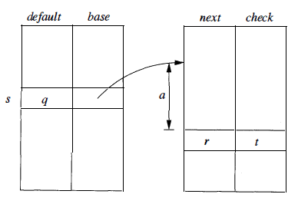
Two dimensional Table
A more subtle data structure that allows us to combine the speed of array access with the compression of lists with defaults.
A structure of four arrays:

Slide 29
Two dimensional Table..
The base array is used to determine the base location of the entries for state s , which are located in the next and check arrays.
The default array is used to determine an alternative base location if the check array tells us the one given by base[s] is invalid.
To compute nextState(s,a) the transition for state s on input a, we examine the next and check entries in location l = base[s] +a
Here character a is treated as an integer.
Range 0 to 127.

Slide 30
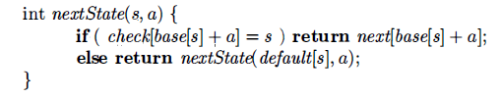
Two dimensional Table...
If check[l] = s then this entry is valid, and the next state for state s on input a is next[l]
If check[l] ≠ s then we determine another state t = default[s] and repeat the process as if t were the current state.
Function nextState

Slide 31
Terminologies
Tokens
The lexical analyzer scans the source program and produces as output a sequence of tokens, which are normally passed, one at a time to the parser.
Some tokens may consist only of a token name while others may also have an associated lexical value that gives information about the particular instance of the token that has been found on the input.
Lexemes
Each time the lexical analyzer returns a token to the parser, it has an associated lexeme - the sequence of input characters that the token represents.

Slide 32
Terminologies..
Patterns
Each token has a pattern that describes which sequences of characters can form the lexemes corresponding to that token.
The set of words, or strings of characters, that match a given pattern is called a language.
Buffering
Because it is often necessary to scan ahead on the input in order to see where the next lexeme ends, it is usually necessary for the lexical analyzer to buffer its input.

Slide 33
Terminologies...
Regular Expressions
These expressions are commonly used to describe patterns.
Regular expressions are built from single characters, using union, concatenation, and the Kleene closure, or any-number-of, operator.
Regular Definitions
Complex collections of languages, such as the patterns that describe the tokens of a programming language, are often defined by a regular definition, which is a sequence of statements that each define one variable to stand for some regular expression.
The regular expression for one variable can use previously defined variables in its regular expression.

Slide 34
Thank You

